Slide 1

Considerations for the Optimal Radio Astronomy Site
Rob Millenaar
SKA Organisation, UK
AFRICON URSI BEJ, Mauritius, September 2013

Slide 2
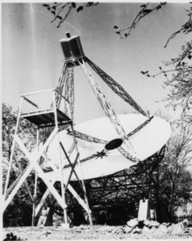
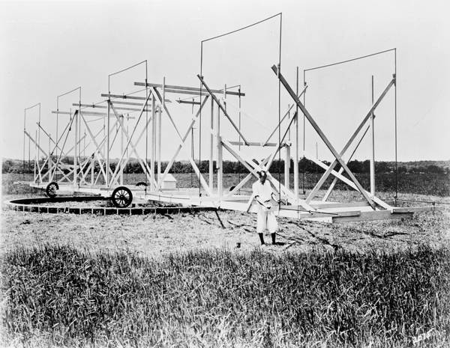
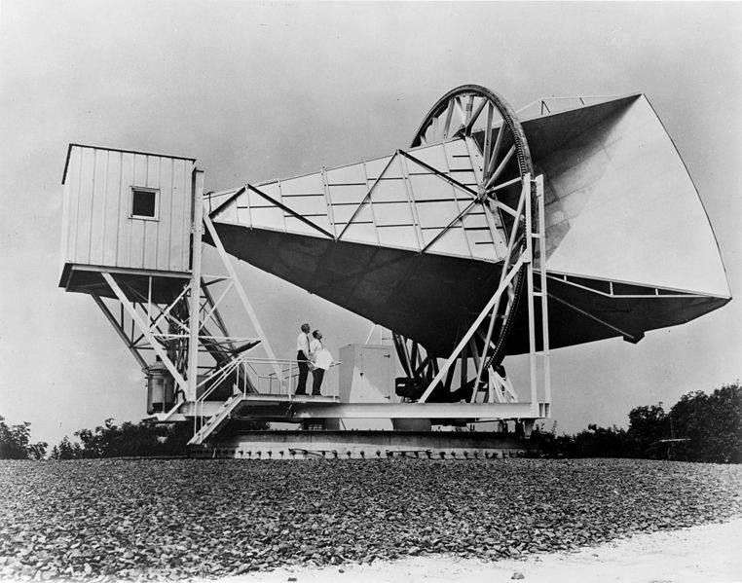
Setting the scene
Radio Astronomy research started in backyards and at radio labs.
Grote Reber at home
Karl Jansky at Bell Labs
Penzias and Wilson at Bell Labs

Slide 3
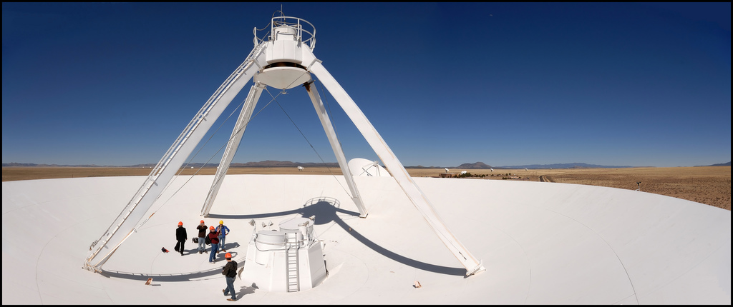
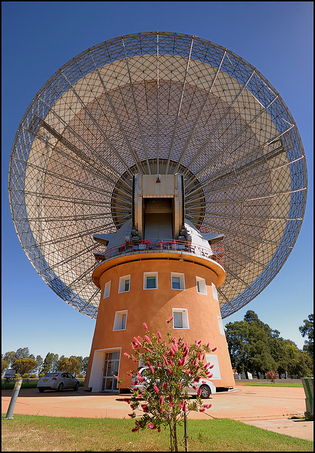
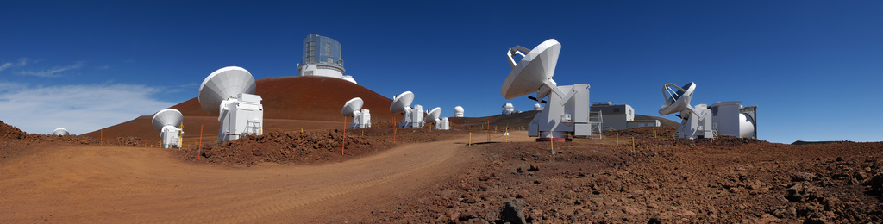
Setting the scene
As the discipline matured telescopes got built at dedicated locations.

Slide 4
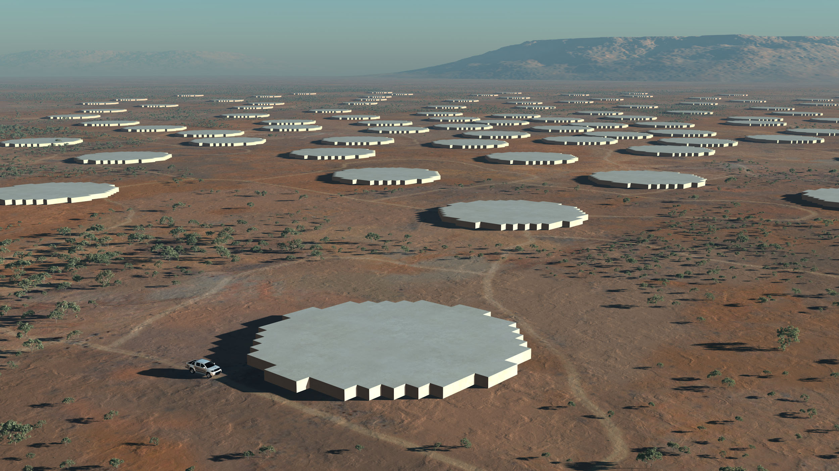
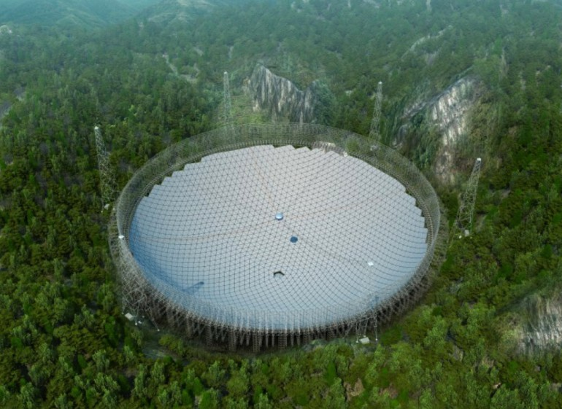
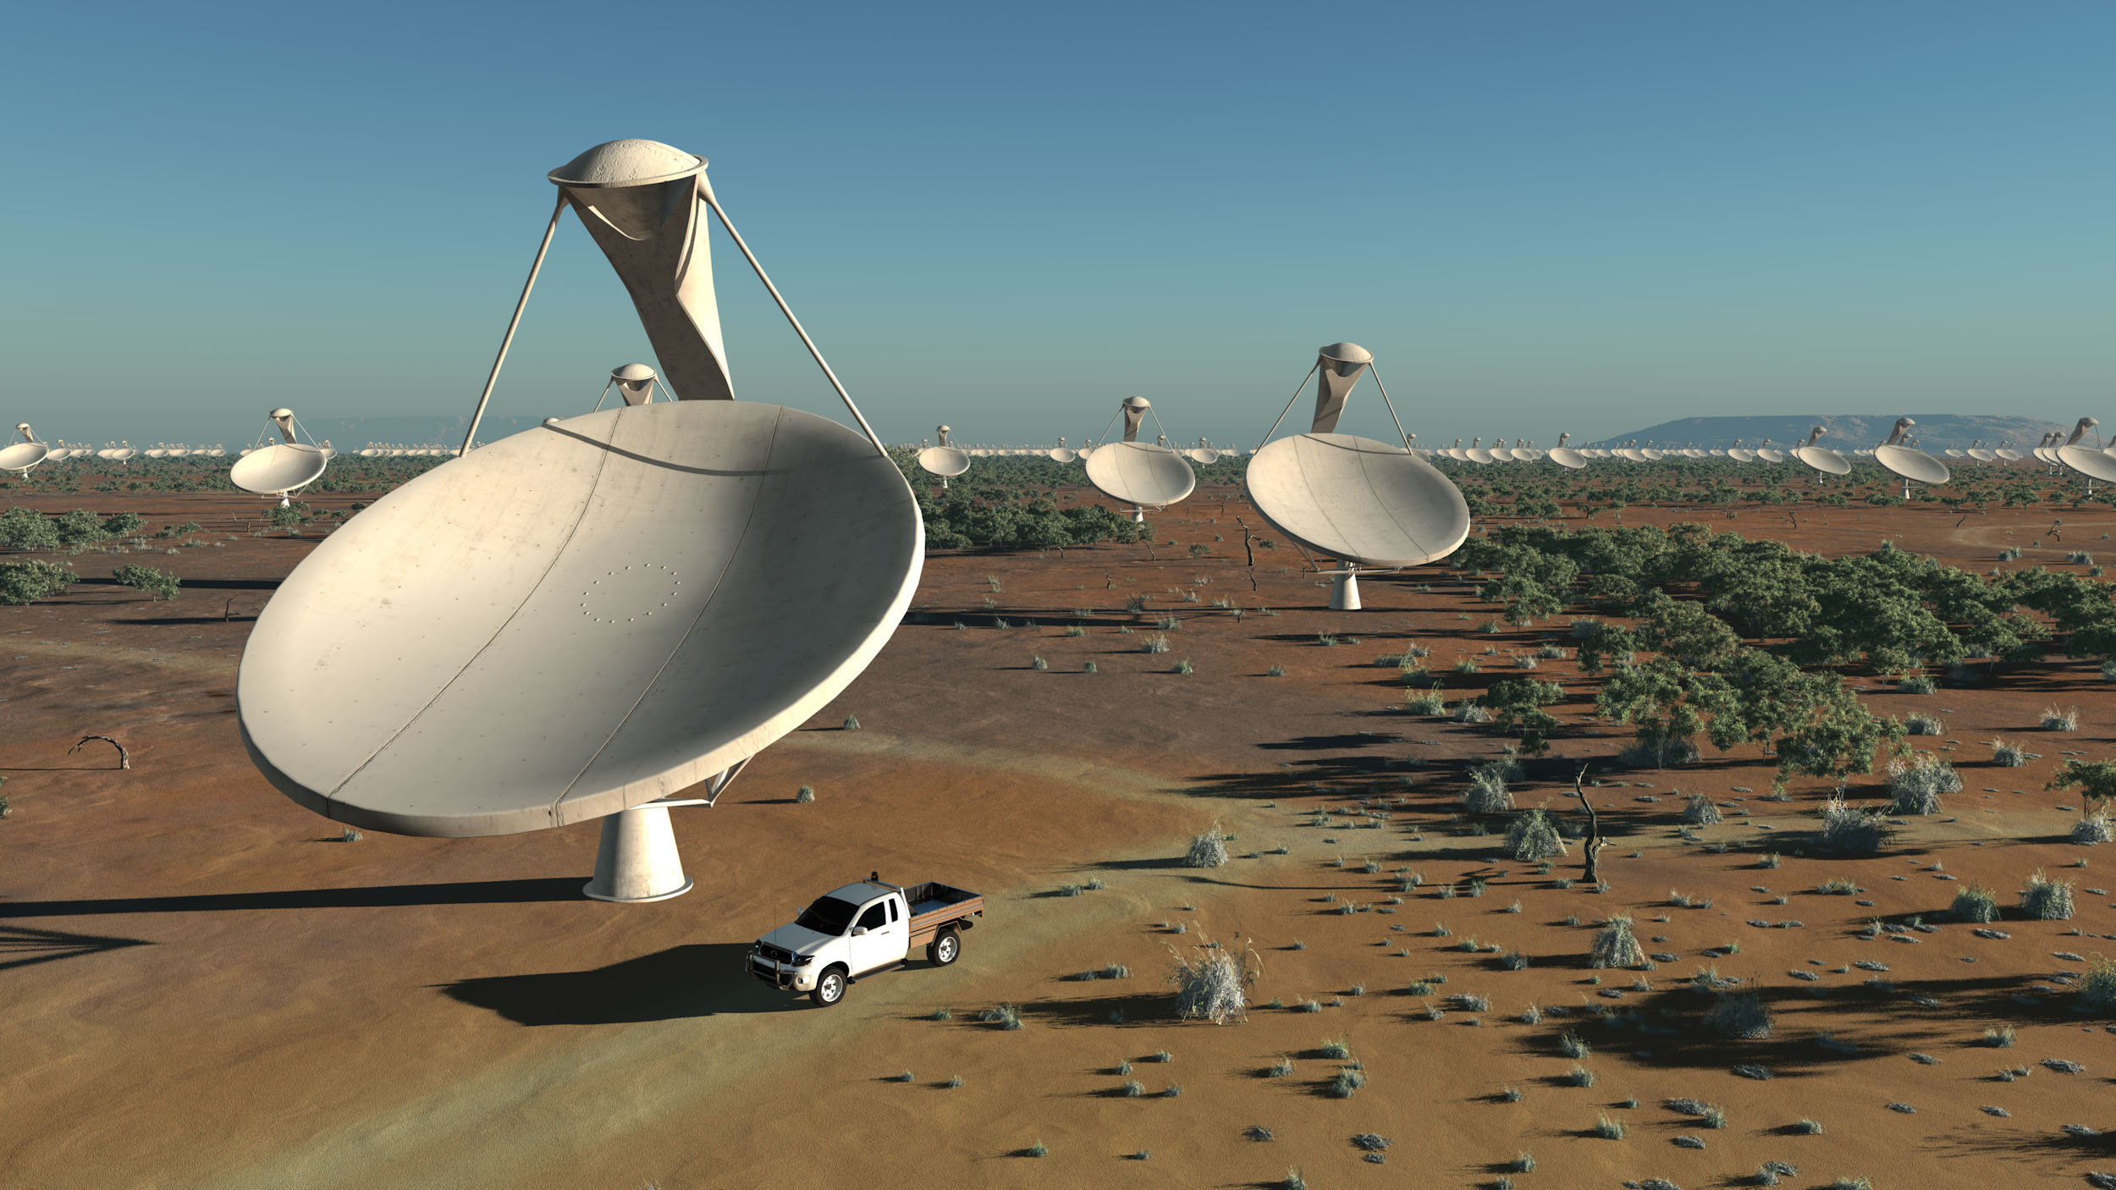
Setting the scene
For the next generation of radio telescopes new sites will have to present an optimum in a range of factors that influence the viability of doing the intended research.

Slide 5
Setting the scene
Entering the Square Kilometre Array:
It will have unprecedented sensitivity brought along partly by the large collecting area. The increase relative to existing telescopes is several orders of magnitude.
It will be spread out over a large area, ultimately spanning a continent. This is true for SKA Phase 2 when baselines of at least 3000 km are foreseen.
It will consist of thousands of parts. Case in point are Aperture Arrays; the low frequency AA will have in the order of a quarter million receiving elements.
All receiving technologies combined, it aims to have continuous frequency coverage.

Slide 6
The SKA
The selection of the sites for the SKA and the allocation of elements of SKA Phase 1 were announced early 2012.
Numbers according to the baseline design of early 2013:
Where | What | Frequency | Number | Extent
South Africa | SKA1-Mid (dishes)+MeerKAT | 0.35-13.8 GHz | 254 (190+64) | ~100km
 | SKA1-AIP-Mid (MFAAs) | 0.4-1.4 GHz
Australia | SKA1-Low (LFAA) | 50-300 MHz | 911* | ~100km
 | SKA1-Survey (PAFs on dishes)+ASKAP | 0.7-1.8 GHz | 96 (60+36) | ~100km

Slide 7
Selecting a site
So how do we select a site for a new radio telescope, and how did we eventually arrive a the sites for the SKA?
In an ideal world one goes from
science requirements, to
telescope design, to
site selection
However, some realism: Expecting to have a scientific requirement first, from which follows a telescope design, and subsequently an optimum site that is selected for it, is perhaps somewhat naive. There are many examples where the order of things is not so straightforward…

Slide 8
Selection Factors
  Factors based on the science to be done (the “science case”)
  Sky access
  Frequency range
  Telescope type, extent
  Factors based on the environment
  The ionosphere
  The troposphere
  Climate
  Infrastructure
The ‘other’ category
  Funding, politics, available resources (input)
  Scientific education, prestige (output)

Slide 9
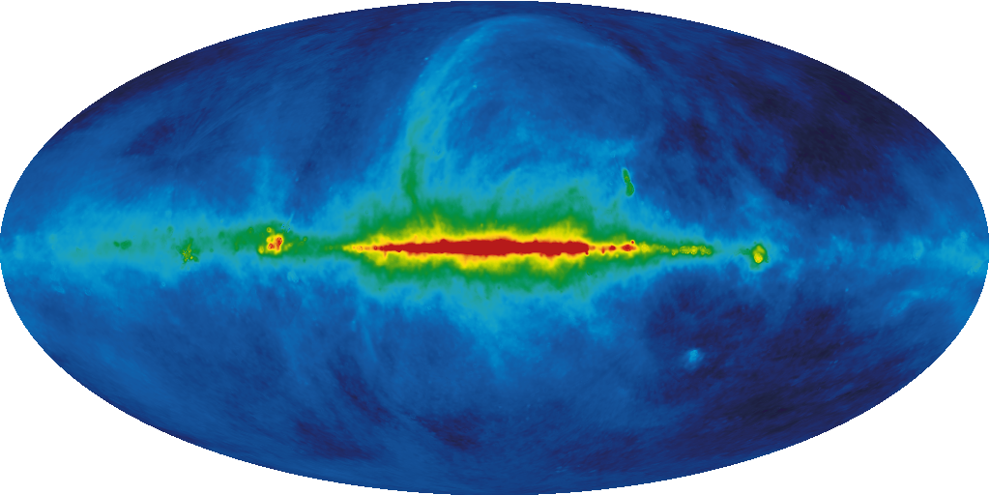
The science factors
Sky access: From our vantage point on the Earth the universe does NOT look the same in all directions. That is because of the foreground objects, most prominently our own galaxy.
The targeted science may impose restrictions on where the telescope needs to be situated, in particular on the Northern or Southern hemisphere.

Slide 10
The science factors
Frequency range: The intended frequency range, as based on the science case, is paramount in determining where the telescope should go, resulting from Environmental Factors, addressed next.
The science in broad terms:
Very high (>30 GHz, up to THz) – Cold gas, molecules, early stages of star formation, proto-planets
High frequencies (>3 GHz) – Galactic and extragalactic morphology, pulsars, star evolution, magnetism
Mid frequencies (>0.3 GHz) – The (neutral) Hydrogen universe (up to 1.4 GHz), OH, galaxy evolution, cosmology, pulsars, SETI
Low frequencies (>0.03 GHz) – Epoch Of Reionisation, the young universe
Very low frequencies (<0.030 GHz) – Solar system, unexplored domain
S K A

Slide 11
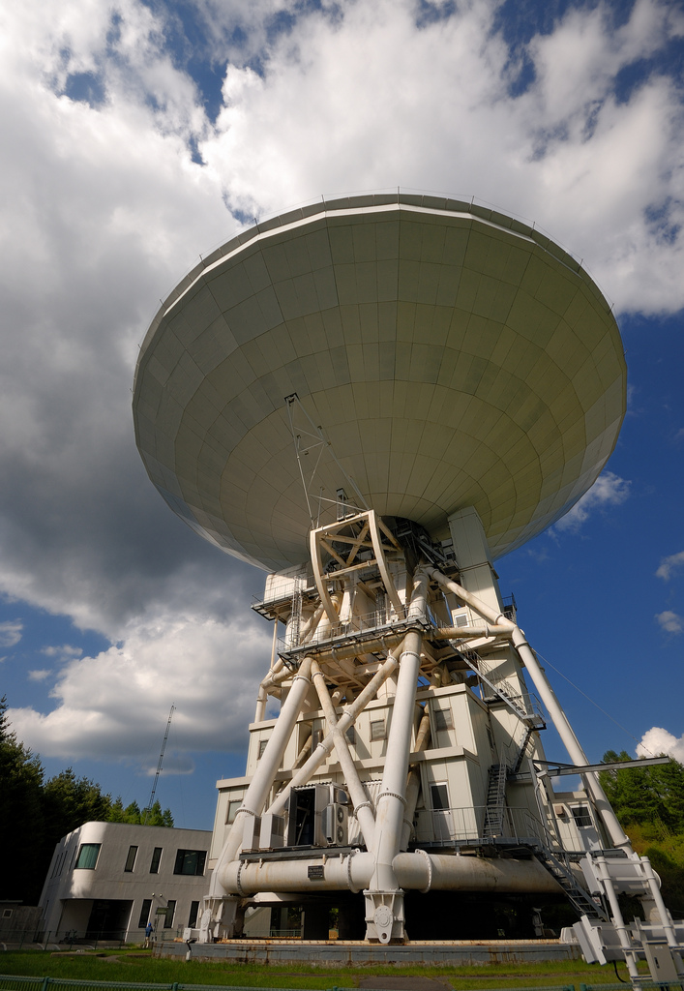
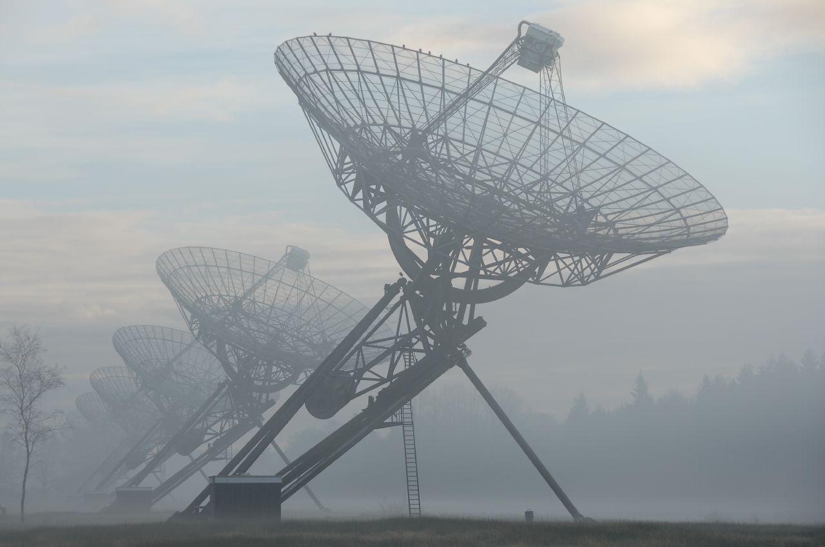
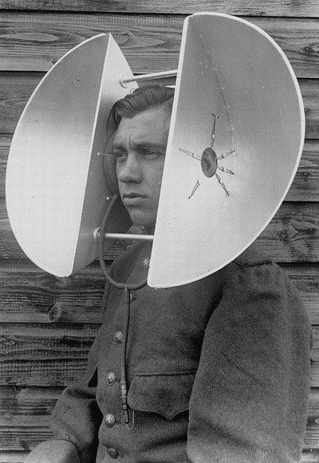
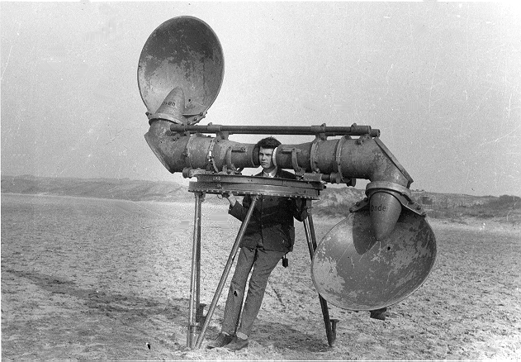
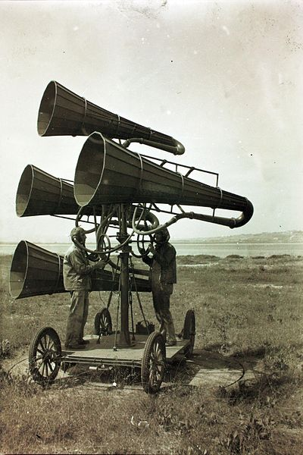
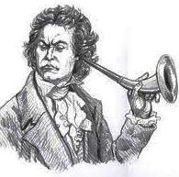
The science factors
Telescope type and extent: Since the start of the discipline the overriding trend has been to go to bigger telescopes, and to more of them, serving ever more demanding science requirements.

Slide 12
The science factors
Telescope type and extent: Either single element (dish) or multiple elements (dishes, aperture arrays) depending on the science. The design parameters are:
single dish | multiple element
sensitivity – A_{phys}/T_{sys} | sensitivity – nA_{eff}/T_{sys}
resolution – λ/D | resolution – λ/B
‘non’-imaging, spectral, time | primarily (spectral) imaging
restricted beam-width, with multiple beam capability | narrow to wide beam-width, with multiple beam capability
 | configuration

Slide 13
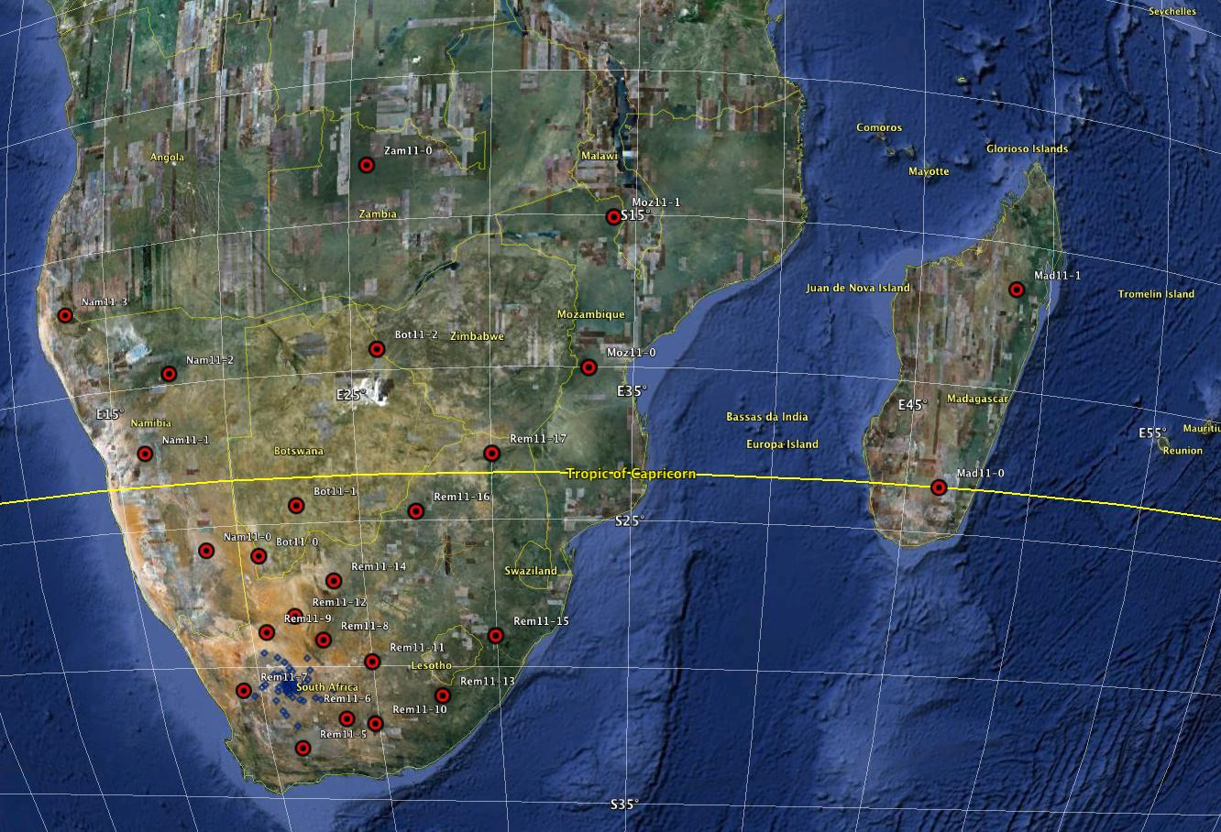
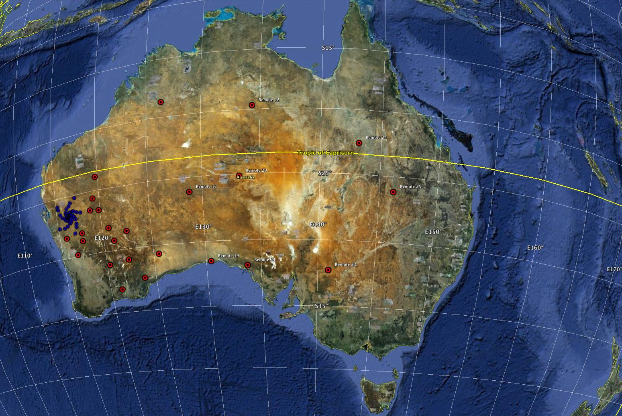
The science factors
Required configuration: In case of a large-scale interferometer the possibilities of locating the antennas in a suitable configuration is important. Here size can matter.
For example, the two proposed configurations for SKA2 evaluated in 2010:

Slide 14
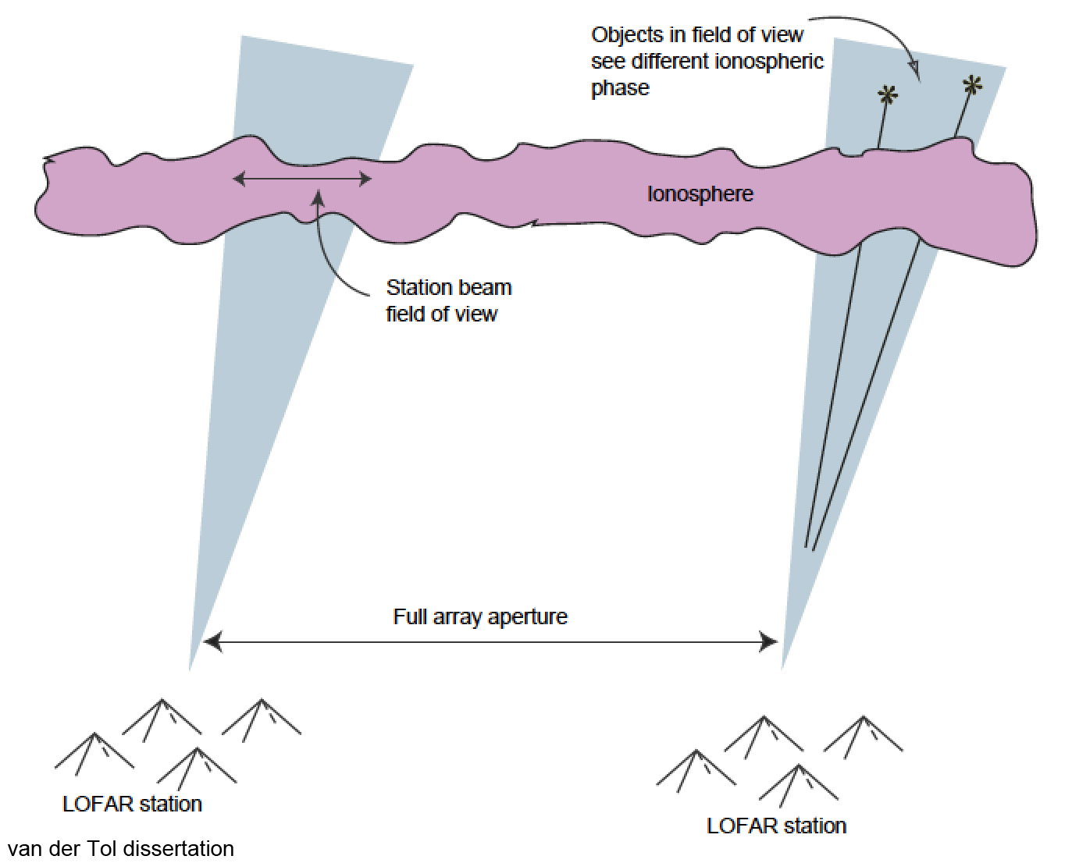
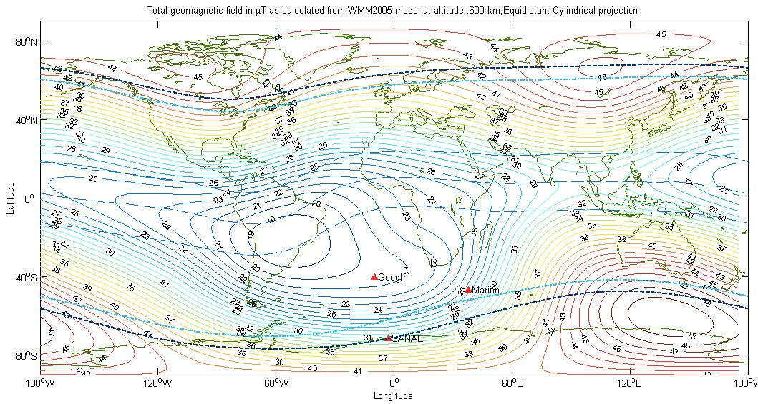
The environmental factors
The ionosphere: causes refraction and amplitude and phase effects that differ in pointing direction, over the location of receiver elements, and over time. Effects are most prominent at lower frequencies.
To be avoided: Geomagnetic regions where influence is greatest, along the magnetic equator and at auroral regions.

Slide 15
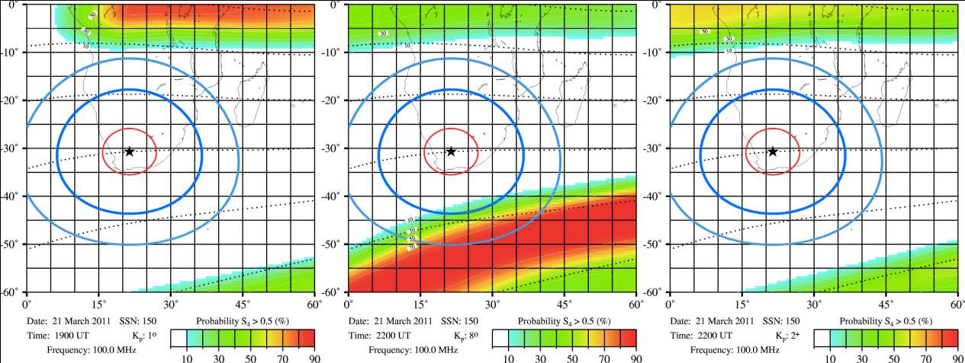
Ionosphere (cont.)
Ionospheric scintillation: model maps at 100 MHz for South Africa, for two worst-case scenarios and one for the most likely condition.
For the SKA sites it turns out that both selected locations have the best conditions in the southern hemisphere.
strong equatorial influence strong auroral influence most likely conditions
Dark and light-blue circles indicate the location of the 5º elevation horizon at altitudes of 300 and 600 km. The red circle indicates the 30º elevation horizon at 350 km altitude.

Slide 16
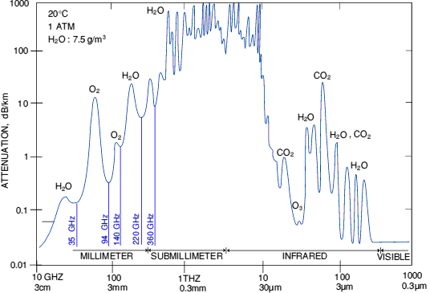
The environmental factors
The troposphere: Well known to affect optical astronomy ‘seeing’, the troposphere affects radio waves through the same phenomena – absorption (attenuation), refraction and phase/delay effects.
Water vapour (and some other molecules) in the lower troposphere causes broad absorption bands that leave some windows for access by radio telescopes.
Mitigating the effect is done by observing from high locations, leaving most of the water vapour below the telescope.
Since the effect is greatest at very high frequencies, millimetre and submillimetre wavelength telescopes are all located on high mountains (Mauna Kea) or plateaus (ALMA).

Slide 17
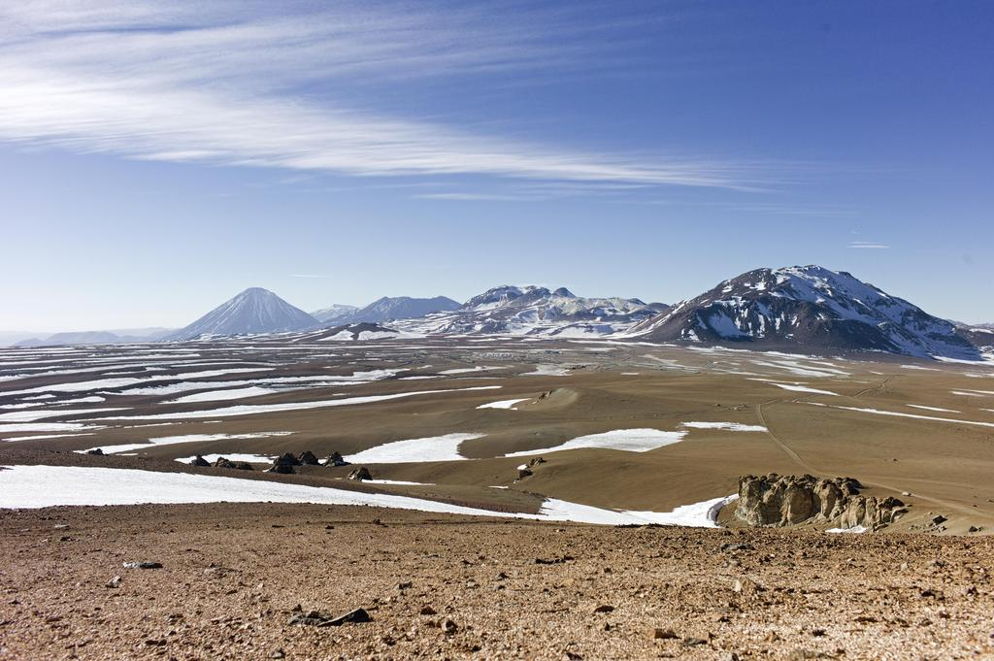
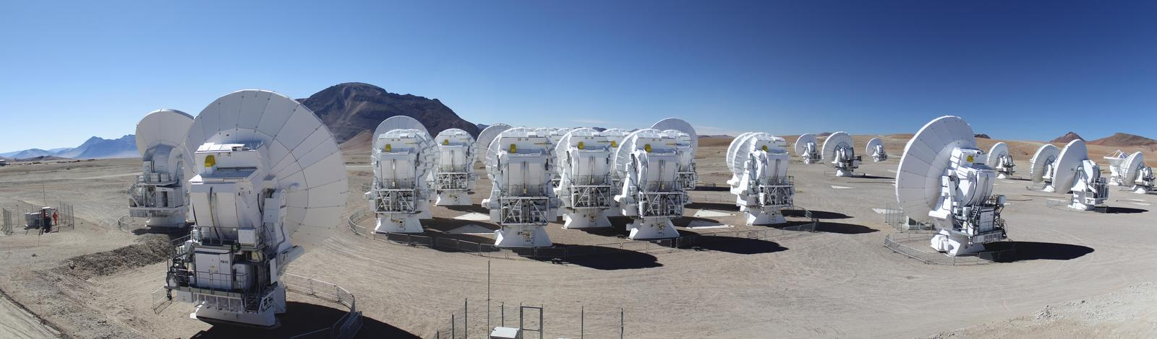
The environmental factors
The troposphere: Well known to affect optical astronomy ‘seeing’, the troposphere affects radio waves through the same phenomena – absorption (attenuation), refraction and phase/delay effects.
Water vapour (and some other molecules) in the lower troposphere causes broad absorption bands that leave some windows for access by radio telescopes.
Mitigating the effect is done by observing from high locations, leaving most of the water vapour below the telescope.
Since the effect is greatest at very high frequencies, millimetre and submillimetre wavelength telescopes are all located on high mountains (Mauna Kea) or plateaus (ALMA).

Slide 18
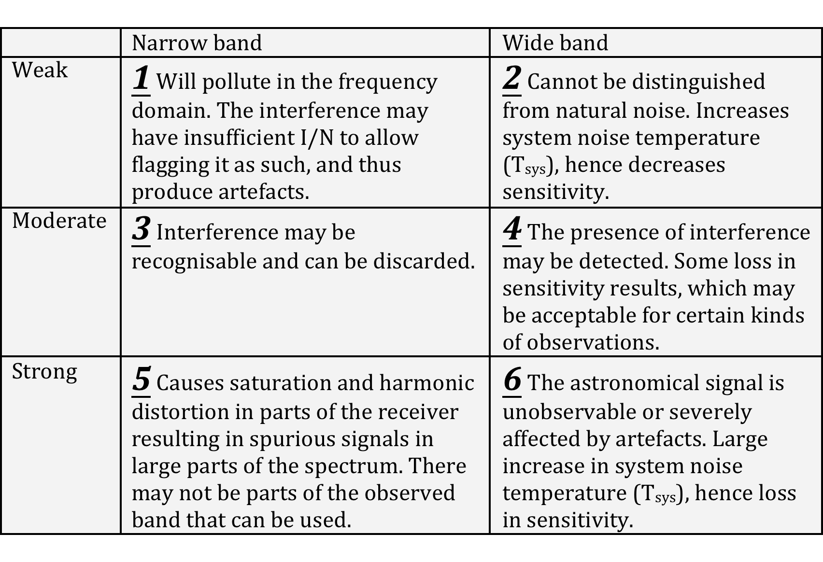
The environmental factors
Radio Interference – RFI and EMI: The influence of manmade radio interference is a very important discriminating factor in site selection. The negative effects of radio interference are (still) under-estimated. RFI diminishes “discovery” space.

Slide 19
Radio Interference (cont.)
Investigation of radio interference at sites through field measurements

Slide 20
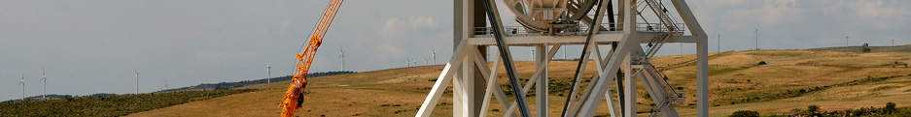
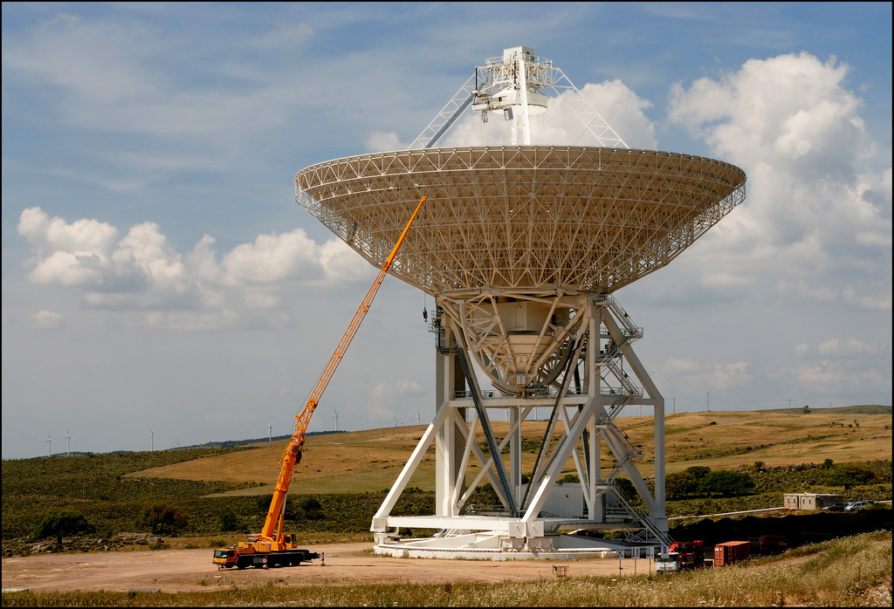
Radio Interference (cont.)
  Protection through Spectrum Management: Radio Quiet Zones (RQZ), establish, legislate, define areas, levels, coordination with other spectrum users.
  Good relationships with local governmental telecom agencies are of utmost importance in order to protect the radio environment for the duration of the lifetime of the telescope.
This is not always easy; it requires a pro-active engagement with the regulatory authority and political support.
The new 64m Sardinia telescope is planned to observe at frequencies from 0.3 to 100 GHz.

Slide 21
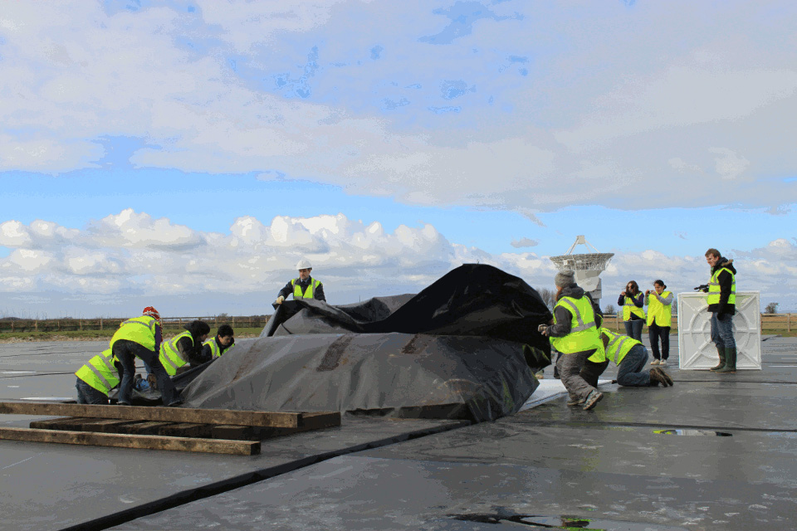
The environmental factors
The climate: The major climate components that affect the viability of operating a radio telescope are:
Temperature – hard on electronics, cost of cooling
Precipitation, clouds – affects transparency of atmosphere (see tropospheric conditions)
Wind – high wind load sets the specifications on dishes, their mounts and foundations.
Benign conditions help to
reduce cost.

Slide 22
The environmental factors
Topology, geophysical, geotechnical: a diverse range of influences on the suitability of a site.
Hills can provide electromagnetic shielding of RFI, but negatively affect access and limit the possibilities for antenna placement in the case of an array.
Bedrock can provide excellent anchoring for dish foundations, but is not suitable for cable burial.
Soil conductivity affects electrical grounding.
Risk of flooding affects placement opportunities of antennas and/or require special measures to prevent damage.

Slide 23
The environmental factors
Infrastructure: existing at the site, or to be designed and built. Large-scale radio telescopes need large-scale infrastructure, most likely in remote areas.
A major cost factor! Some aspects:
Access to and on the site
Roads to the site and on the site
Airstrip
Buildings on-site, for equipment and personnel
During construction
During operations
Connectivity
Fibre connection from telescopes to (on- or near-site) processing facilities to science data centres far away.
Power
Power hungry systems that need to be cooled
Where is power generated; how to transport the power
Around the clock power is required, free from EMI
How does the site support the use or renewables

Slide 24
Summarising
A good site for a (new) radio telescope is as important as
defining the science for it (comes first… maybe),
defining, designing and building the hardware and software for it, and
getting the funds and support for making it all possible.
It is clear that the environment at the site must allow the placement of the required telescope facilities and support the intended science, i.e.:
radio interference
tropospheric stability
ionospheric conditions
climate conditions
infrastructure, existing or planned
available space
We note that the SKA may be the latest and greatest radio telescope that mankind can afford for the foreseeable future. Therefore we better get it right. Having selected the best sites in the southern hemisphere was just the first step along the way.

